Slide 1
Exploring the Art of
Language
Harnessing Machine
Learning for Automatic Poetry
Generation
mid-term oral examination
14/12/2023
Name:zhu yanyan
Supervisor:Zhiyao Liang

Slide 2


Contents
01
02
03
introduction
Preliminary Experimental Results
future plan
what is NLP?
How to make a Chinese poetry generation model
project plan
ongoing work
thesis analysis
project analysis

Slide 3
01.
introduction

Slide 4
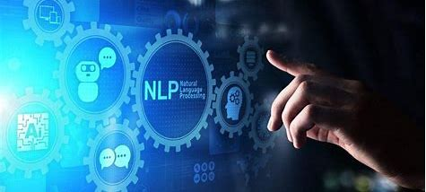
what is NLP ?
how to implement a Chinese text generation mode?
Natural language processing (NLP) is a complex technology involving multiple fields that combines computer science, artificial intelligence, and linguistics.
• Model Development
• Data Collection and Preprocessing
• Model Training
• Model Evaluation
• Improvement and Adjustment
Notes:
I believe that most of us are studying relevant fields, so I don't need to go into details.To implement a Chinese text generation model, I need to train the model through deep learning techniques so that it can capture the details and cultural characteristics of the language. This often involves large amounts of textual data, as well as continuous training and optimization of the model.

Slide 5
Preliminary Experimental Results
02.

Slide 6
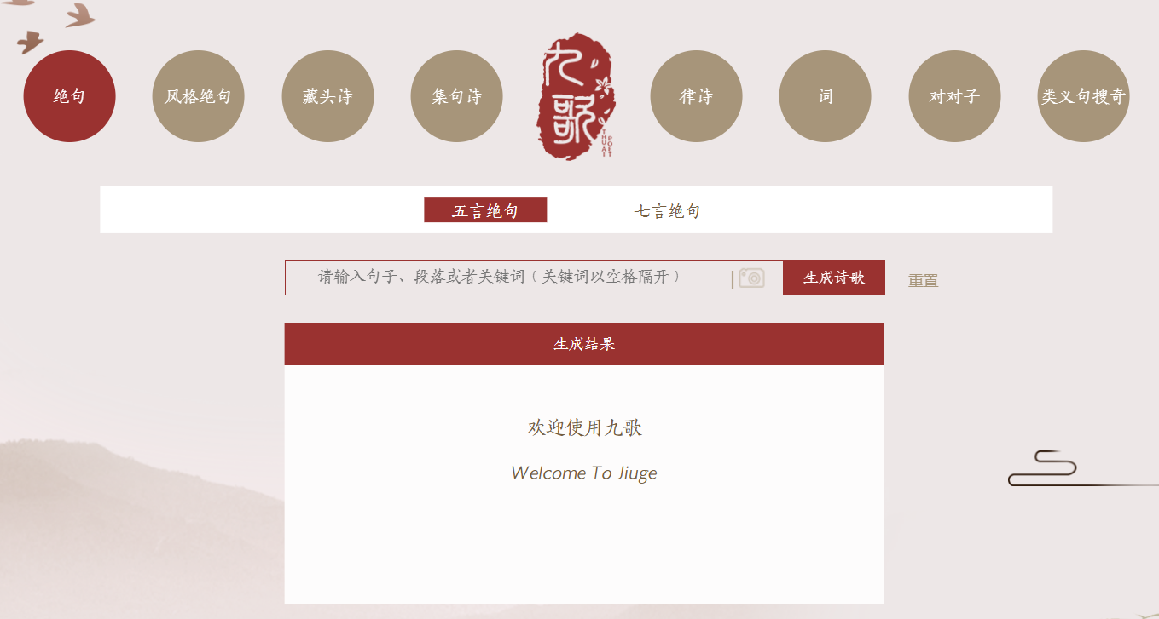
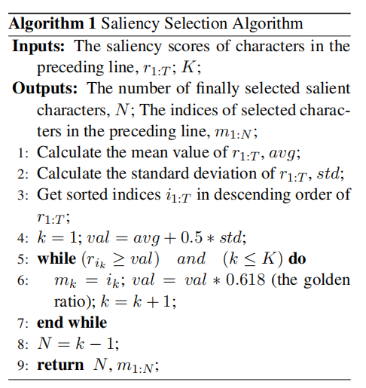
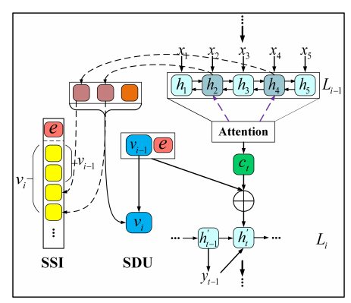
tsinghua Jiuge
Among existing NLP models, Tsinghua University's Jiuge system is a prominent example. It uses deep learning techniques combined with multiple models specifically designed for poetry generation, capable of learning and understanding the "hidden rules" of poetry.
Methodology
Using deep learning technology, combined with a model designed for poetry generation.
Notes:
I first learned about successful cases in this fields.Tsinghua’s JiuGe is an AI poetry writing system developed by qinghua university. The JiuGe system uses the latest deep learning technology, combined with multiple models specifically designed for poetry generation. These models can learn and understand various ”hidden rules” of poetry, such as the level and oblique tones of verses, and rhyme regulations.

Slide 7
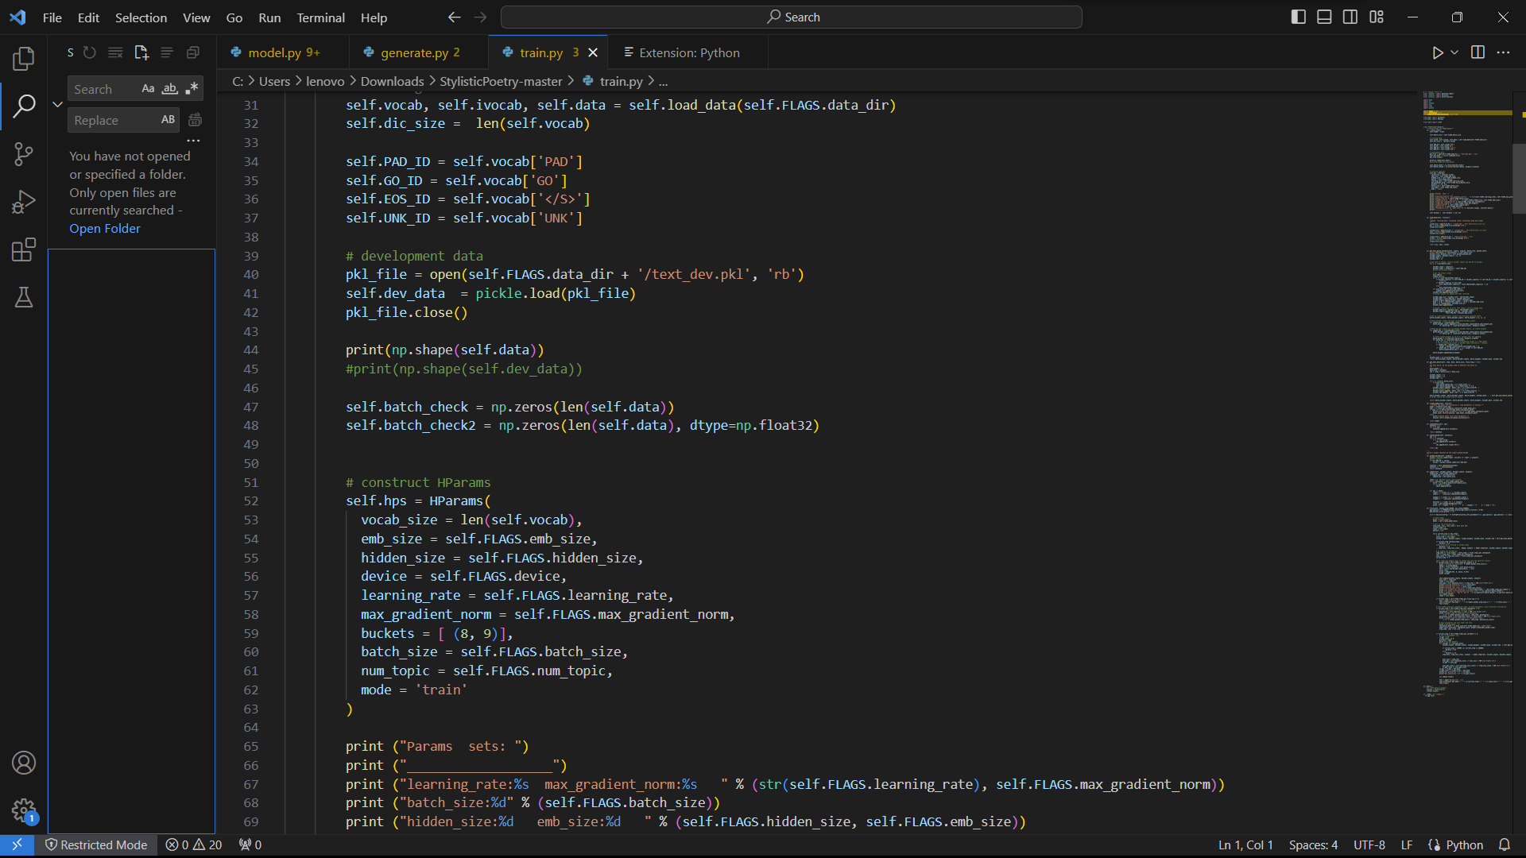
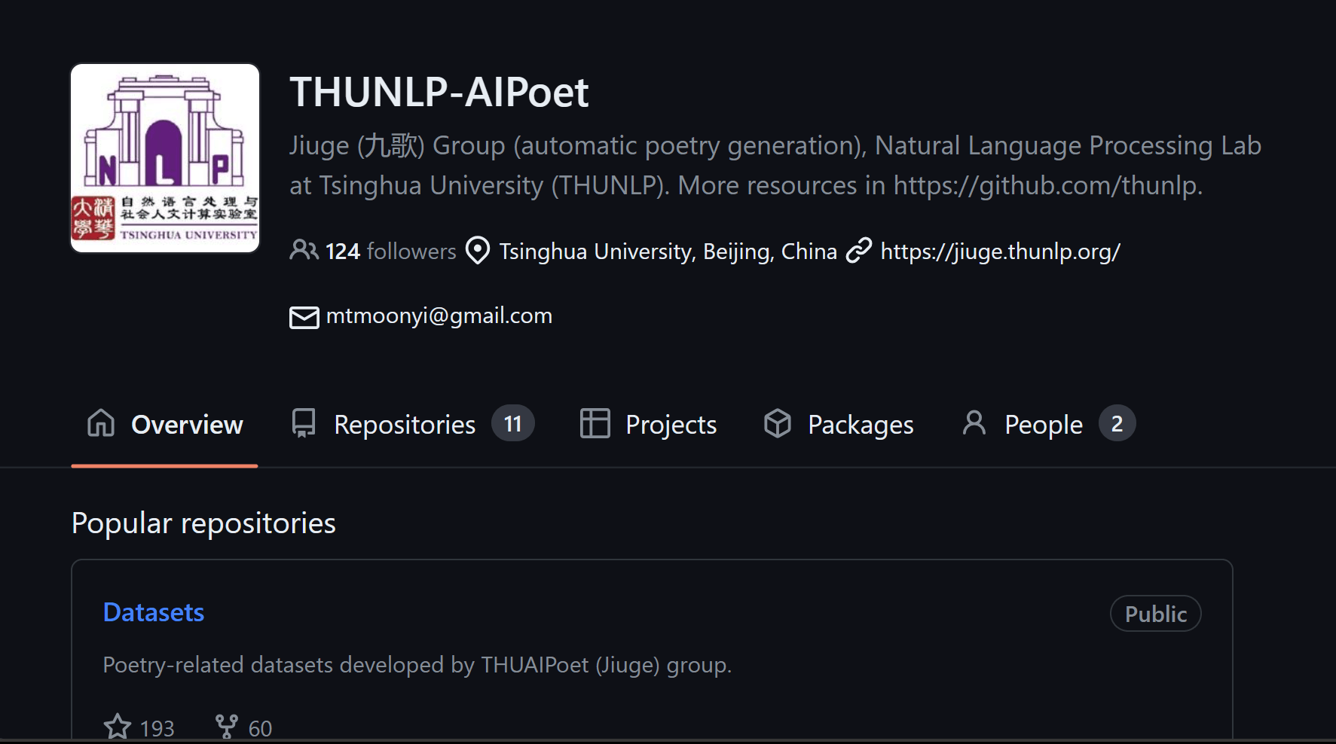
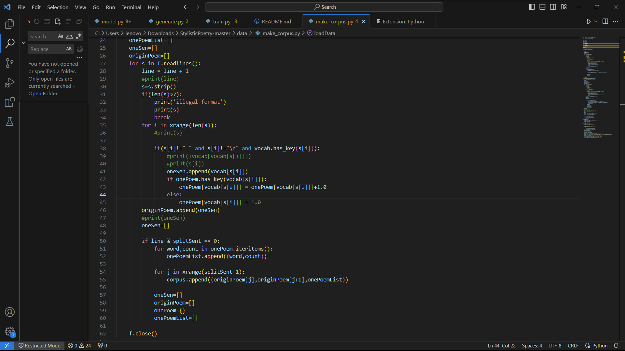
PROs
cROs
Multimodal input:
Multi-genre and multi-style
Man-machine interactive creation mode
There is still room for improvement in the coherence and consistency of poetry generation
Notes:
In order to learn more, I tried to reproduce their project, and here is a screenshot of some of the codes. In the end, I came up with the following advantages and areas that still need improvement.The main features of Tsinghua Nine Songs include: the ability to process different types of input, such as text or pictures to inspire poetry; Can produce a variety of genres and styles of poetry, including quatrains, rhythmic poems, etc. and the drawbacks are also obvious:

Slide 8
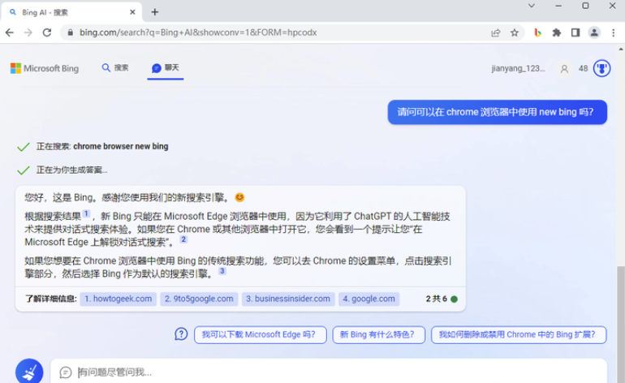
bing ai
Bing AI is an advanced technology developed by Microsoft to improve the accuracy and efficiency of search engines through deep learning and big data analytics.
Methodology
Bing AI supports natural language processing, allowing users to interact with search engines in a more natural way.
Notes:
After that I looked at bing chat, Microsoft's new chatbot, and I also summarized its features.The reason I studied bing AI is that, unlike ChatGPT, which focuses on technologies and applications for natural language understanding and generation, to help users better understand and generate natural language, bing AI is more focused on search-related technologies and applications.But since this is not an open source project, I have not been able to reproduce it successfully.

Slide 9
03.
Project Planning
Notes:
After determining my direction, I realized that I needed a detailed plan to help me realize my research

Slide 10
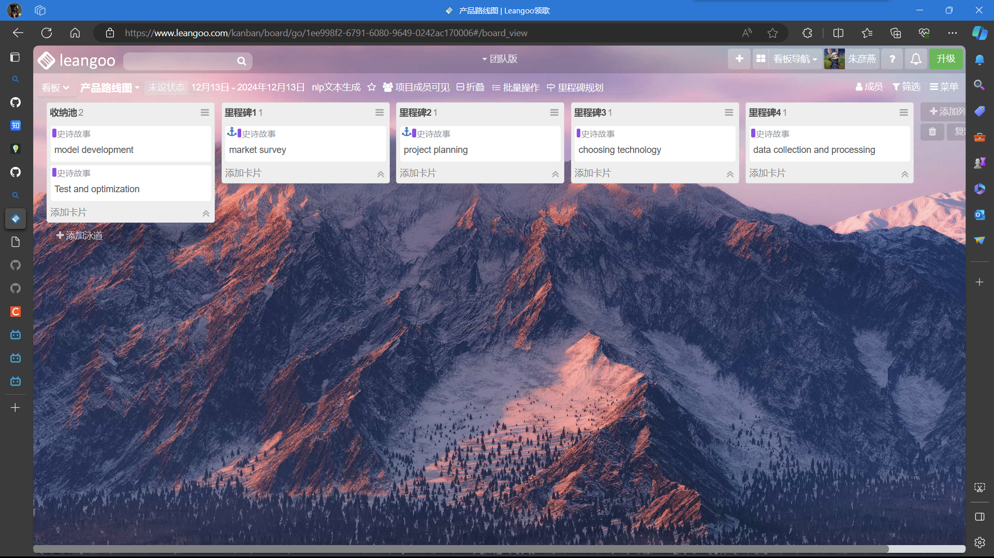
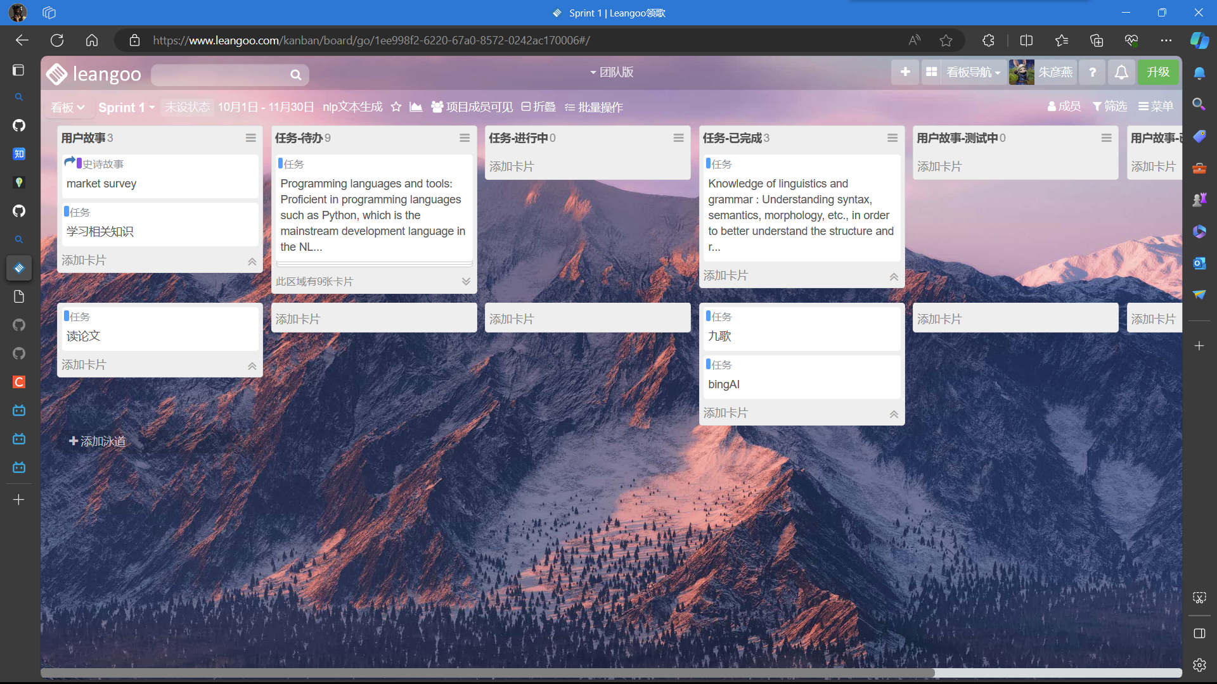
Project Planning
Define Project Scope
Create Project Charter
Collect and organize a large number of Chinese poetry texts as a data set for training models.
Choose a model architecture suitable for Chinese poetry generation, such as Transformer or GPT.
The collected data is used to train the model until it can produce high-quality poetry.
The model is tested and optimized through user feedback to improve the quality and speed of poetry generation.
Notes:
After determining my direction, I realized that I needed a detailed plan to help me realize my research. I combined the knowledge related to software design learned before, kept the thinking of agile development, and set up milestones and sprints I divided my tasks into the following parts: data collection, model selection, model training, testing and optimization. My next job is to continue the reproduction and learning of the poetry generation project.

Slide 11
reference
Yi, Xiaoyuan, et al. “Chinese Poetry Generation with a Working Memory Model.” Proceedings of the International Joint Conference on Artificial Intelligence (IJCAI). 2018.
Zhang, Zhe, et al. “Stylistic Chinese Poetry Generation via Unsupervised Style Disentanglement.” Proceedings of the Conference on Empirical Methods in Natural Language Processing (EMNLP). 2018.
Liu, Zhipeng, et al. “MixPoet: Diverse Poetry Generation via Learning Controllable Mixed Latent Space.” Proceedings of the AAAI Conference on Artificial Intelligence (AAAI). 2020
H. Brendan McMahan, Eider Moore, Daniel Ramage, Seth Hampson, Blaise Agüera y Arcas. "Communication-Efficient Learning of Deep Networks from Decentralized Data." arXiv:1602.05629⁷.
"Microsoft Academic: is the phoenix getting wings?" SpringerLink.
"Towards Asynchronous Motor Imagery-Based Brain-Computer Interfaces: a joint training scheme using deep learning." arXiv:1808.10852⁸.

Slide 12
Thanks !

